Slide 1
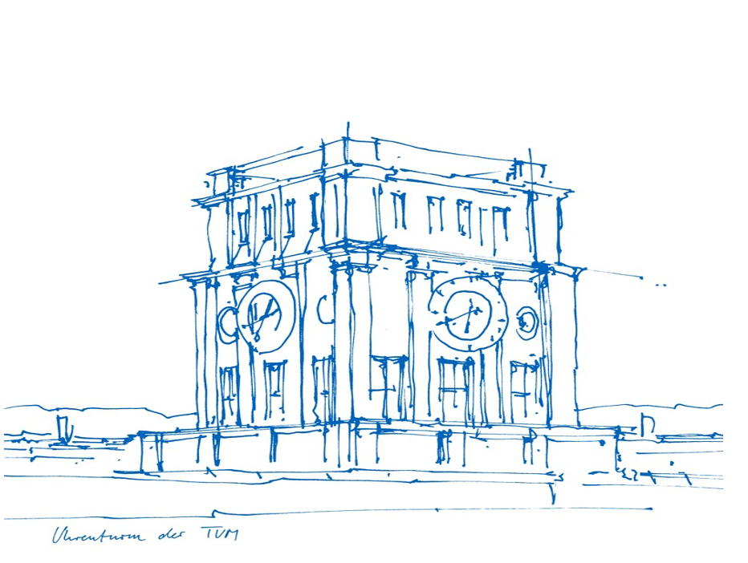
Cargo Conveyor Belt System Mid Term Presentation
Group E/05:
Yikai Kang (03728450)
Ming Gui (03687866)
Bowen Ma (03721259)

Slide 2
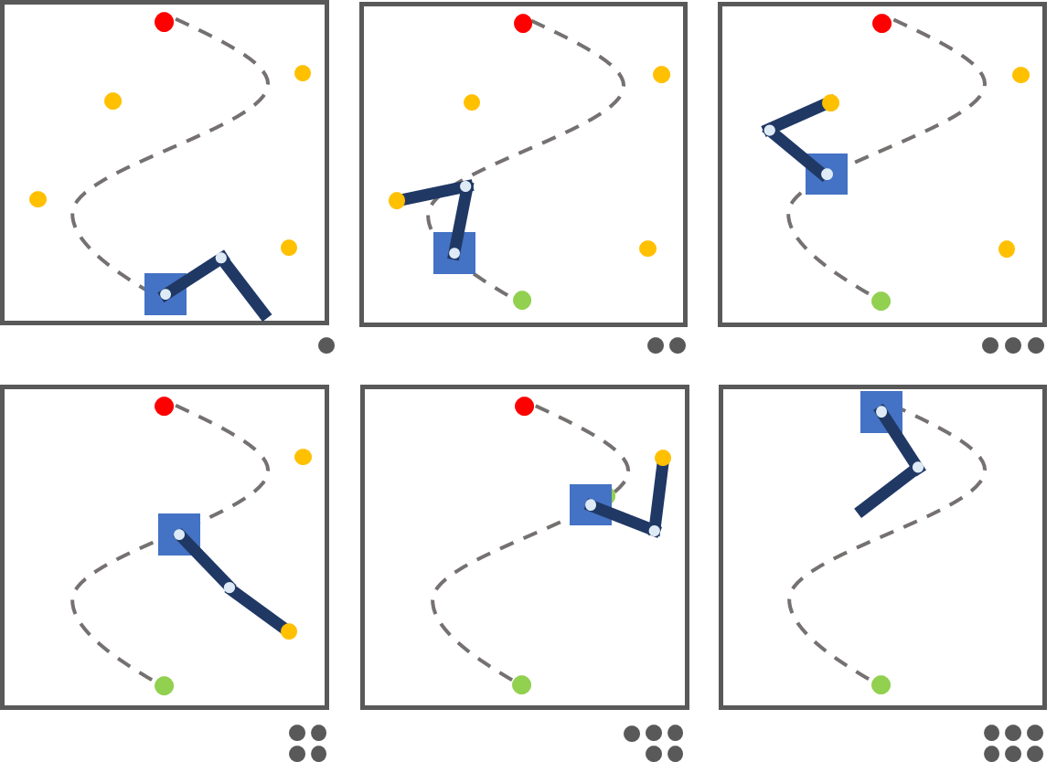
Basic Introduction to Our Project
Elements
The base of the robot
Two robotic arms
Four cargos locations
Goal
Collect the cargos
Highest rewards, ASAP

Slide 3
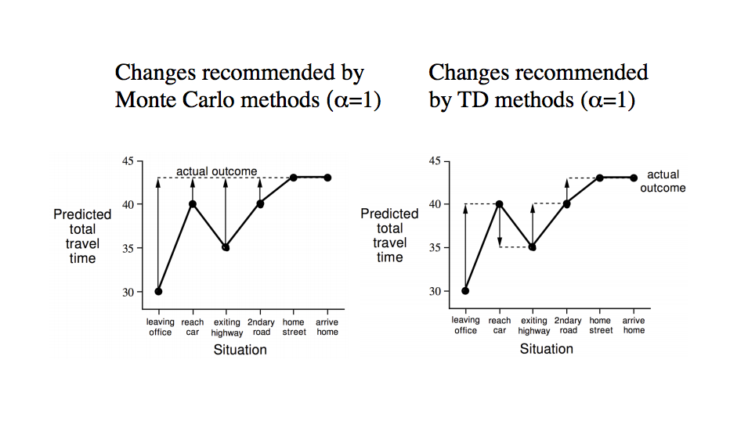
Reinforcement Learning: Q_Learning
Temporal difference (TD)
Update every previous step for every iteration
[1]
Trial-and-Error
More suitable for models with a large state space
[1] Adapted from http://kvfrans.com/model-free-prediction-and-control/

Slide 4
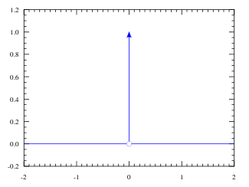
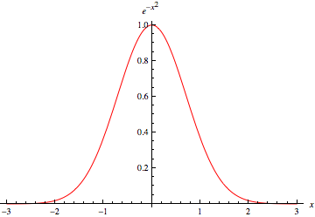
Sparse Reward vs. Dense Reward
Sparse Reward:
Dense Reward:
Continuity in Reward function leads to better and faster RL convergence

Slide 5
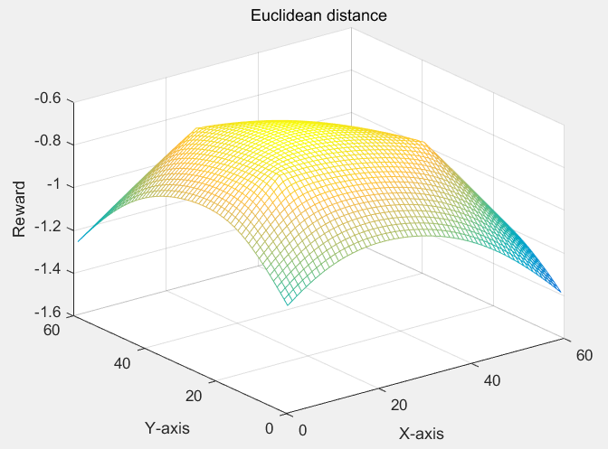
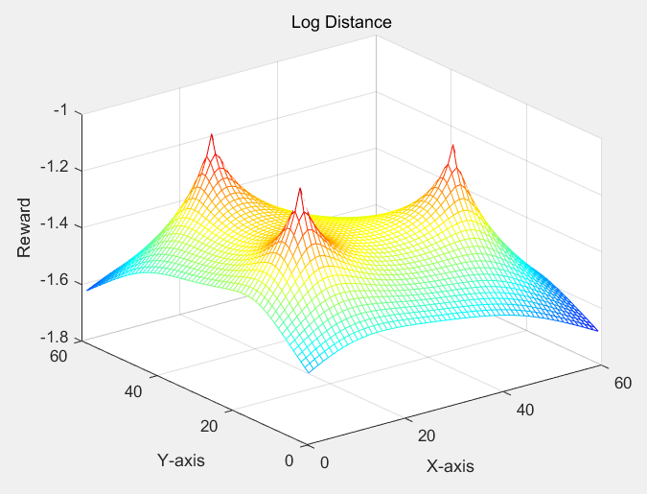
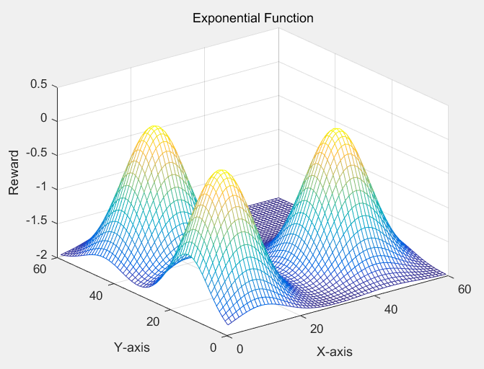
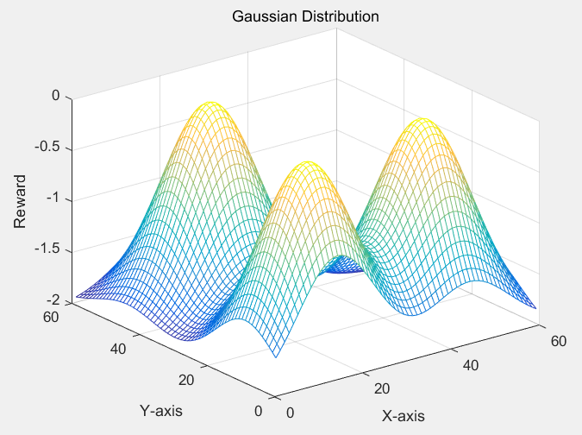
Potential Rewards Model

Slide 6
Work Packages
Environment
Gym
RL Algorithms
Pandas
Numpy
Numpy

Slide 7
Task Assignment
Kang: Mainly responsible for building up our environment
Gui: Mainly responsible for designing our reinforcement learning algorithm
Ma: Mainly responsible for the adjustment of actions and rewards
Next Steps
Optimize our environment
Debug our RL algorithms
Test different reward functions

Slide 8

Thanks for listening!
Questions?

